Slide 1
BUNDLING THE NGSS
June 28, 2016 Webinar
Notes:
Jennifer

Slide 2

Introductions and Overview
Why bundle the Next Generation Science Standards (NGSS)?
What are the Example Bundle documents?
How can the Example Bundle documents be useful?
nextgenscience.org/bundling
Notes:
Jennifer

Slide 3


About Achieve
  Committed to ensuring all students graduate from high school “college and career ready” so students are academically prepared for next steps after high school.
  Work with states to raise academic standards and graduation requirements, improve assessments, and strengthen accountability systems.
  Partner with state governments, reform agencies, policy organizations, and other stakeholders to conduct research, provide technical assistance on policy execution, develop advocacy resources, and communicate results.
Notes:
Jennifer

Slide 4



Today’s Presenters
Rita Januszyk
Retired science educator from Gower West Elementary in Illinois; NGSS consultant
Rita was an elementary educator for many years. She served as a writer on the NGSS writing team, NGSS Diversity and Equity Team, NGSS Example Bundles, and the Illinois State Board of Education Model Science Resource Project. Rita is one of the editors and contributors of the book NGSS for All Students.
Chris Embry Mohr
High School Science Teacher, Olympia High School, Stanford, IL
Chris has taught science and agriculture for over 20 years in rural Illinois and was a member of the NGSS Life Science Writing Team. She serves in various leadership roles and conducts professional development workshops throughout the Midwest.
Michael Harris
1st Grade Teacher, Chico, California
Michael Harris has been a teacher in Chico, California for 32 years. He has worked with the K12-Alliance and has provided science professional development throughout the state for over 25 years. In addition, he worked on the NGSS Example Bundles for K-1.
Notes:
Jennifer

Slide 5
How much time have you already spent implementing the NGSS?
POLL QUESTION
Notes:
Jennifer
POLL #1: How much time have you already spent implementing the NGSS?
More than 3 years
Between 1 and 3 years
Less than 1 year
I have just begun getting to know the NGSS

Slide 6
Why Bundle?
Notes:
Jennifer transitions to Rita

Slide 7

NGSS Performance Expectations are Three-Dimensional
Crosscutting Concepts
Core Ideas
Practices
Notes:
Rita
Hello everyone!
The Framework for k-12 Science Education published by the National Research Council articulated three dimensions of science learning: Science and Engineering Practices, Crosscutting Concepts, and Disciplinary Core Ideas.
And The Framework recommended that the new science standards emphasize all three dimensions.
By doing that the competencies such as knowing key concepts, understanding the role of models, and the features of argumentation are accomplished more effectively when students engage in practices.
Additionally offering opportunities for engagement increases participation of all students.

Slide 8
Notes:
Rita
Aligning with the Framework recommendations, the NGSS were written as performance expectations.
Here’s a Middle School physical science example of a standard with the foundation boxes below. As a quick review let’s look at the parts.
The stem in every standard reads
Students who demonstrate understanding can .. This is a performance expectation or PE
The standard reads
Analyze and interpret data on the properties of substances before and after the substances interact to determine if a chemical reaction has occurred. T
In this standard the practice is analyze and interpret data. In the foundation box in blue is the practice and the bullet is the element of the practice that further defines the intent of the demonstration of understanding: Analyze and interpret data to determine similarities and differences in findings.
The standard includes a reference to the disciplinary core idea and The entire DCi is found in the orange box .
In this standard the crosscutting concept of patterns is found in the green and is implied in the standard. Students look for a pattern of change comparing properties before and after a chemical reaction.

Slide 9
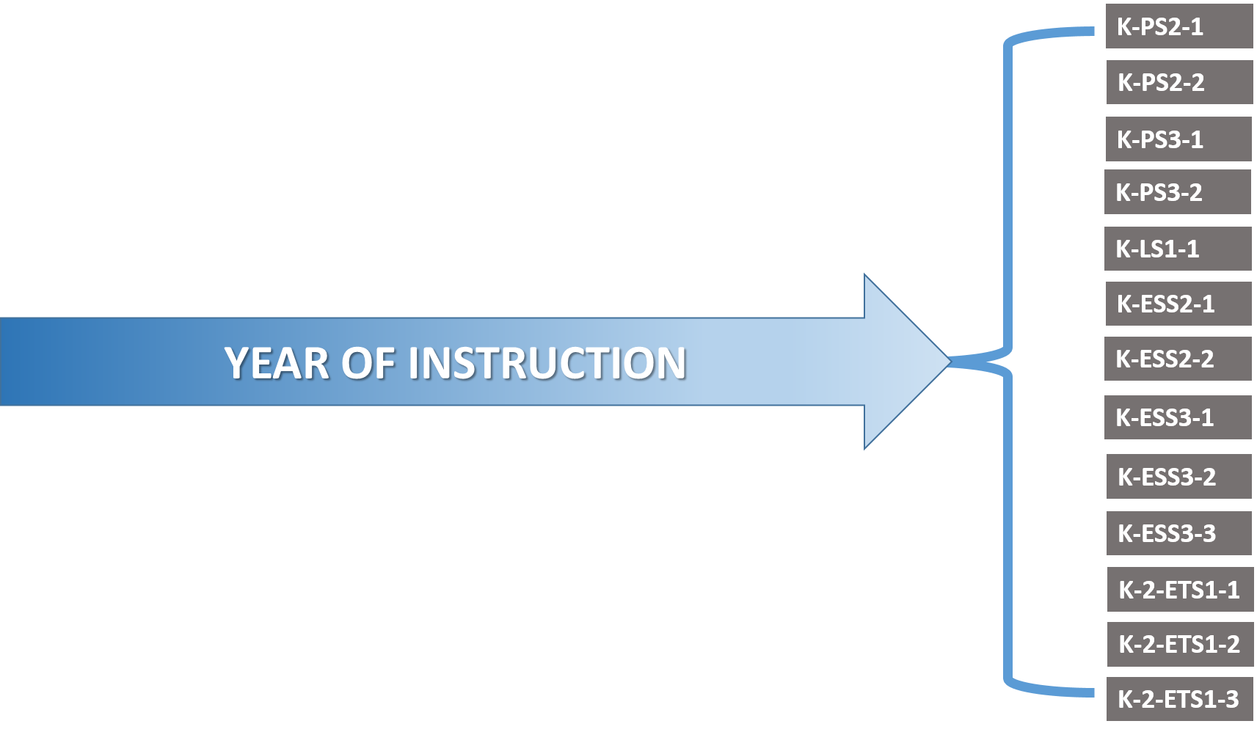
NGSS PEs Describe the Endpoints of Instruction
Notes:
Rita
So A standard reads like an activity in the classroom.
In fact, this standard from middle school physical science would be a very good classroom activity, and it is probably an activity in some form in many curriculums currently.
But the standard is not curriculum or a lesson. It’s intent is to measure understanding at the end of the grade or grade band.

Slide 10
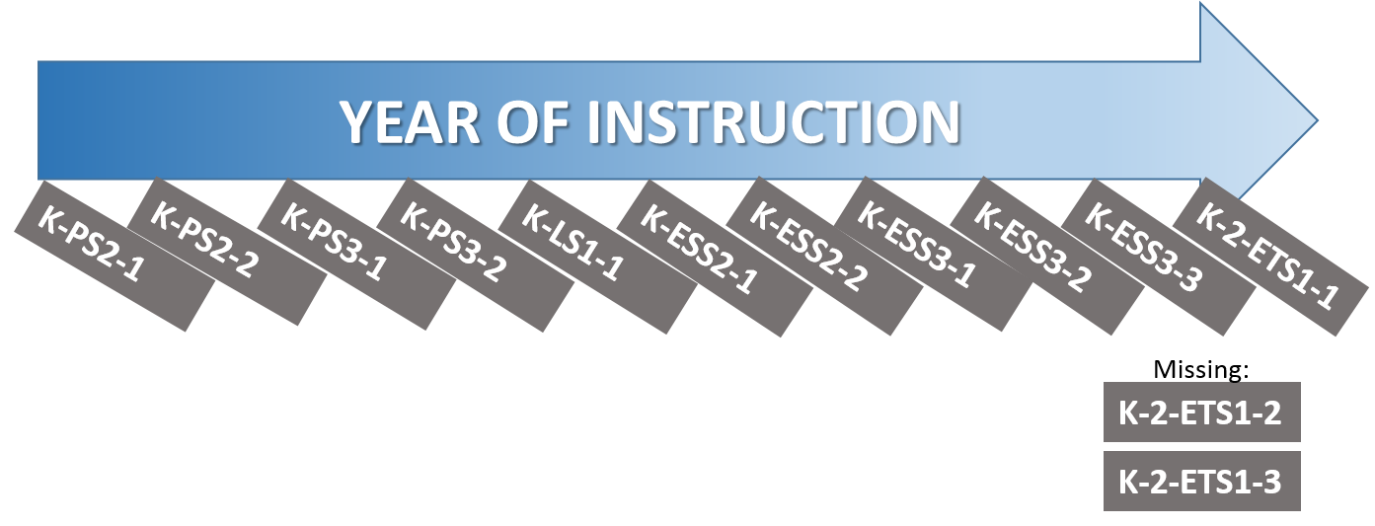
PEs Are Often Taught One-By-One
Notes:
Rita
Since the PEs look like lessons and instruction, they appear to be able to be taught as a list, one after the other, in a year of instruction.
A while ago I joined a large number of experts who got together in teams to create example groupings of PEs or bundles. In order to show examples of how standards can be grouped or bundled together.
Thinking of the PEs in a more dynamic way was a challenge at first.
The work that we did creating these sample bundles was an iterative process. It was a journey for us from our initial thinking about PEs to our final understanding of PEs. Like some of you we began with the thought that a PE has three dimensions and those dimensions should occur together in a series of lessons. Working with Achieve our initial ideas evolved.

Slide 11
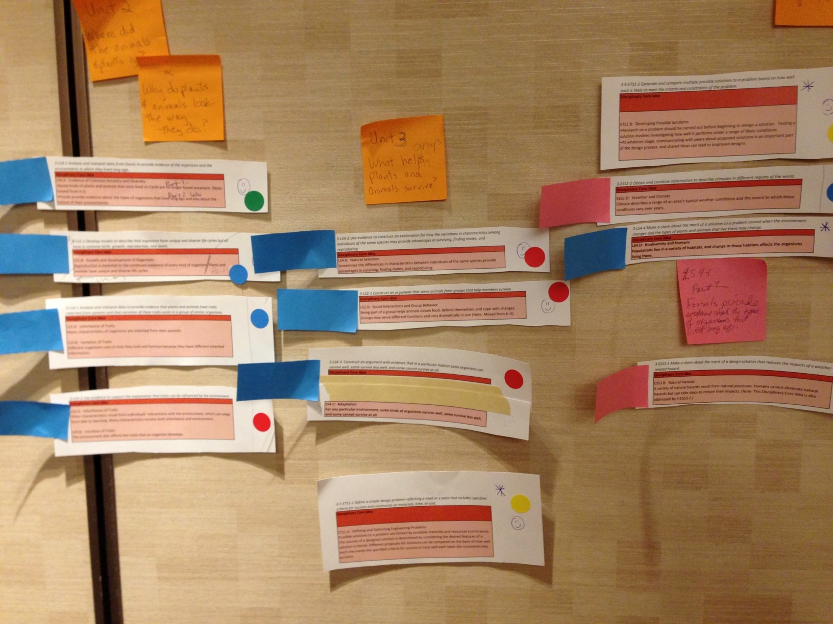
Planning for Coherence
Inspect PEs
Line up DCIs
  No black boxes
Notes:
Rita
How did we approach the work of bundling the PEs?
The first task was to carefully and methodically read through the PEs and supporting foundation boxes. Checking for understanding and asking questions to help our understanding. Often checking the Framework for further clarification.
Then we cut up the DCIs and lined them up and combined them into tentative units.
This is an image of one our 3rd grade bundles
Red boxes are core ideas
Dots are CCC
Red and pink Post-it notes are disciples.
Other post-it notes are titles, themes, or notes.
We looked at the progression of understanding students would develop over a unit or year. We found some connections between disciplines and grouped, not by PEs, but by the connections.
A very important part of this DCI line up was to make sure that there were no black boxes.
If a unit needed an idea to understand another idea, we thought both ideas should be taught in the unit together .
Telling students “we will learn about that later in the year” would be a block box statement.

Slide 12
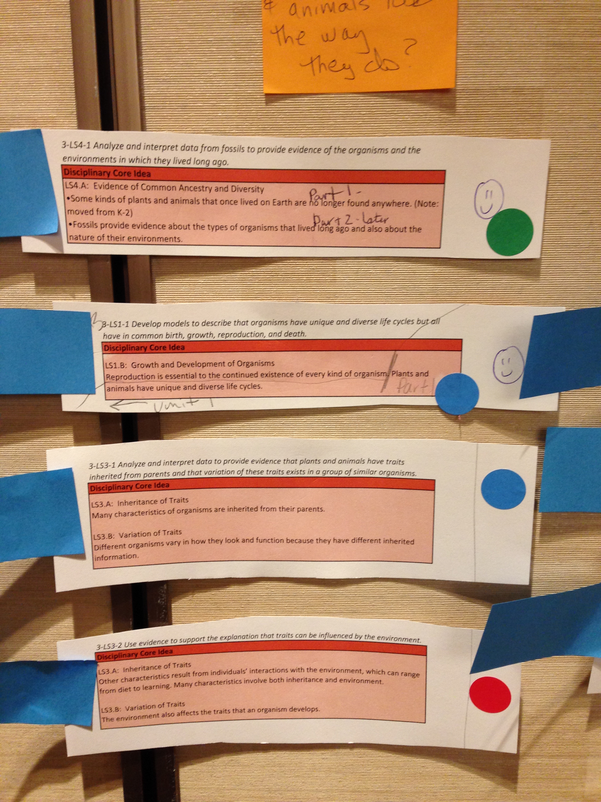
Connecting Ideas
Phenomena
Questions
Crosscutting concepts
Notes:
Rita
As we arranged the DCIs into coherent units of study, we found commonalities in our discussions that led to thinking about
How a particular bundle arrangement might lead to meaning making for students,
what are the connections, what holds these ideas together?
We talked through possible unifiers such as questions, phenomena, and crosscutting concepts.
The red box in this slide highlights another flexibility of bundling. Sometimes we split a DCI associated with a PE into two different units. In this third grade example, the PE 3-LS4-1 has two DC bullets associated with it and we separated them into separate units.
Since these are end of year standards we have the flexibility to sometimes separate the parts and place them into a meaningful context.

Slide 13
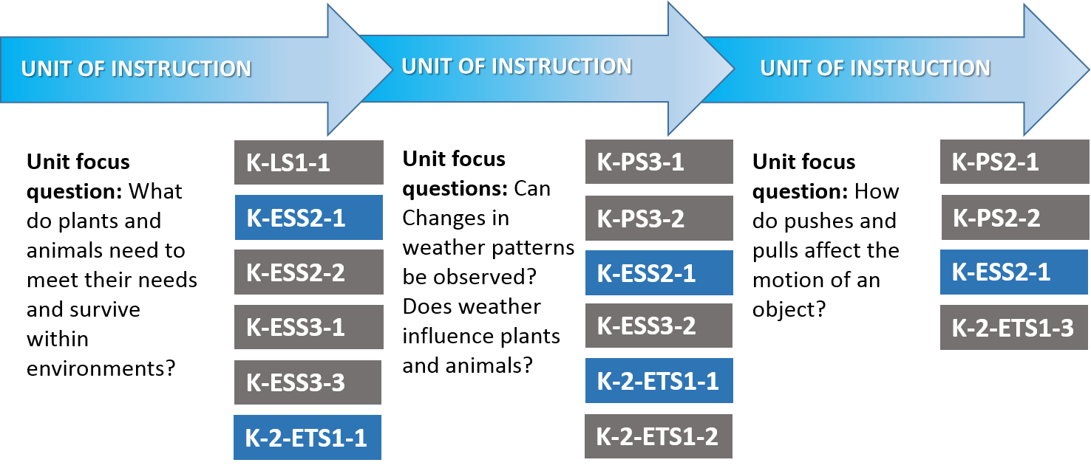
NGSS PEs Can Be Bundled
Notes:
Rita
But as we worked on creating these bundles of PEs, we realized that several bundling possibilities could be created.
For example, we bundled PEs one way with an engineering emphasis, another way with a crosscutting concept emphasis, and then with a integrated approach.
In fact, currently I’m working on a 5th grade lesson writing project and we bundled the PEs in yet another way different from the bundles that will be shared online.

Slide 14
Why Bundle the NGSS?
Show connections between ideas
Facilitate phenomenon-driven ideas
Save instructional time
Notes:
Rita
Why bundle the PEs of the NGSS?
By bundling the PEs, we increase the possibility of having coherent units that help students find connections between ideas.
Bundling can lead students to explain phenomena with three dimensional learning.
Teaching one PE then another and so on is time consuming. I’m not sure it can even be done with the time constraints of schools especially in elementary. Bundling may turn out to be more time economical.

Slide 15
Questions so far?
Notes:
Rita

Slide 16
What role do you play in curriculum development?
POLL QUESTION
Notes:
Rita (at the end of the results Rita transitions to Chris)
POLL #2: What role do you play in curriculum development?
It is my full-time focus
It is a significant part of my job
I modify pre-existing curricula for my classroom
I use pre-developed curricula in my classroom
I do not use curricula in my role

Slide 17
What are the NGSS Example Bundles?
Notes:
Chris
Since most of you are involved in curriculum development to some degree, let’s discuss how these example bundles can be useful.
One possible early step in translating the N G S S into curriculum and instruction is to ‘bundle’ or group standards or Performance Expectations together. In other words, grouping standards or P Es together in such a way to show connections between ideas, facilitate phenomenon-driven instruction, and as a classroom teacher, I am especially concerned about saving instructional time.
As Rita stated, bundles of standards can form end goals for instruction that are similar to traditional curricular units and objectives. And thus, several bundles together form a course or year-long instructional plan for science.
What are the Example Bundles?
Each Example Bundle Course includes:
A Course Summary
A Bundle Document for each bundle
and, A Course Flow Chart

Slide 18
Course Summary Document
Kindergarten Topic Model Narrative and Rationale: The three bundles in this Kindergarten model are characterized by the overarching ideas that weather, sunlight, and the needs of living things affect us daily—ideas that apply to the physical, life, and Earth and space sciences, as well as engineering. Bundle 1 centers on a guiding question about pushes and pulls on objects and their effects. Bundle 2 centers on a guiding question about the needs of plants and animals for food, water, and sunlight to survive. Bundle 3 centers on a guiding question about patterns and effects of sunlight. While this framework is arranged by topic, the study of weather occurs throughout the year, over time. In Kindergarten students begin to build their understanding of the Crosscutting Concepts (CCCs) of patterns and the relationship between cause and effect in a logical progression over time. This model also introduces students to the Science and Engineering Practices (SEPs). It places special emphasis on planning and carrying out investigations, analyzing and interpreting data, engaging in argument from evidence, and constructing explanations and designing solutions. However, additional SEPs should be used throughout instruction. The SEPs contribute to students’ understanding of both the CCCs and the DCIs they explore in Kindergarten. Students become familiar with SEPs over the course of the year, and the level of sophistication at which they are able to engage in the SEPs increases over time.
Bundle 1: How do objects move and what happens when they interact? ~4 weeks | Bundle 2: What is the relationship between the needs of different plants and animals and the places they live? ~18 weeks | Bundle 3: What can we observe about sunlight? ~14 weeks
K-PS2-1. Plan and conduct an investigation to compare the effects of different strengths or different directions of pushes and pulls on the motion of an object. K-PS2-2. Analyze data to determine if a design solution works as intended to change the speed or direction of an object with a push or a pull.* K-ESS2-1. Use and share observations of local weather conditions to describe patterns over time. Begins building toward K-ESS2-1, but it is not assessable in this bundle. K-2-ETS1-3. Analyze data from tests of two objects designed to solve the same problem to compare the strengths and weaknesses of how each performs. | K-LS1-1. Use observations to describe patterns of what plants and animals (including humans) need to survive. K-ESS2-1. Use and share observations of local weather conditions to describe patterns over time. Begins building toward K-ESS2-1, but it is not assessable in this bundle. K-ESS2-2. Construct an argument supported by evidence for how plants and animals (including humans) can change the environment to meet their needs. K-ESS3-1. Use a model to represent the relationship between the needs of different plants and animals (including humans) and the places they live. K-ESS3-2. Ask questions to obtain information about the purpose of weather forecasting to prepare for, and respond to severe weather. K-ESS3-3. Communicate solutions that will reduce the impact of humans on the land, water, air, and/or other living things in the local environment.* K-2-ETS1-1. Ask questions, make observations, and gather information about a situation people want to change to define a simple problem that can be solved through the development of a new or improved object or tool. | K-PS3-1. Make observations to determine the effect of sunlight on Earth’s surface. K-PS3-2. Use tools and materials provided to design and build a structure that will reduce the warming effect of sunlight on Earth’s surface.* K-ESS2-1. Use and share observations of local weather conditions to describe patterns over time. K-2-ETS1-2. Develop a simple sketch, drawing, or physical model to illustrate how the shape of an object helps it function as needed to solve a given problem.
Notes:
Chris
Let’s take a look at the example bundle - Kindergarten Topic Model.
The Example Bundle Course Summary Document includes:
Narrative and Storyline and bundle descriptions:
The course summary document introduces a user to the themes of the year-long course, and briefly describes the way those themes are derived from the arrangement of the P Es within the bundles of the course.
Note in the third paragraph – the summary document specifies the SEPs and CCCs that will be emphasized throughout the year. And, please note that “However, additional SEPs should be used throughout instruction. The SEPs contribute to students’ understanding of both the CCCs and the DCIs they explore in Kindergarten. Students become familiar with SEPs over the course of the year, and the level of sophistication at which they are able to engage in the SEPs increases over time.”
The second part of the summary document includes the bundle descriptions.
There is one column for each bundle, indicating the number of example bundles in the course – in this case, 3.
the PEs grouped within those bundles are listed and a suggested instructional duration for each bundle.
Note – under bundle 1 and bundle 2 – that two of the PEs are only partially assessed in these bundles and will be fully assessed in bundle 3. This is another way to help tie the bundles together over the course of the year.

Slide 19
Bundle 1 Question: This bundles is assembled to address the questions of “How do objects move and what happens when they interact?”
Summary The bundle organizes performance expectations around the topic of how pushes and pulls affect the motion of an object. Curriculum developed from this bundle should always maintain the three-dimensional nature of the standards, but recognize that instruction is not limited to the practices and concepts directly linked with any of the bundle performance expectations. Connections between bundle concepts In instruction leading to this bundle of performance expectations, students learn that: Pushing or pulling on an object can change the speed or direction of its motion and can start or stop it (PS2.A as in K-PS2-1 and K-PS2-2). This concept of motion connects to the idea that a bigger push or pull makes things speed up or slow down more quickly (PS3.C as in K-PS2-1). The concept of pushing or pulling on an object (PS2.A as in K-PS2-1 and K-PS2-2) also connects to the idea that when objects touch, or collide, they push on one another and can change motion. (PS2.B as in K-PS2-1) The idea that a bigger push or pull makes things speed up or slow down more quickly (PS3.C as in K-PS2-1) connects to the concept that pushes and pulls can have different strengths and directions (PS2.A as in K-PS2-1 and K-PS2-2). The concept that people measure weather conditions to describe and record the weather and to notice patterns over time (ESS2.D as in K-ESS2-1) connects to the idea that it is useful to compare and test designs (ETS1.C as in K-2-ETS1-3) through data analysis. The ideas that a situation that people want to change or create can be approached as a problem to be solved through engineering (ETS1.A as in K-PS2-2) and that, because there is always more than one possible solution to a problem, it is useful to compare and test designs (ETS1.C as in K-2-ETS1-3) could connect to multiple physical science concepts in this bundle. For example, these concepts could connect to the idea that when objects touch or collide, they push on one another and can change motion (PS2.B as in K-PS2-1) through a task in which students are challenged to work in groups to change the direction or speed of a ball with another object and then test and compare each group’s solution. Alternatively, these engineering concepts could connect to the idea that a bigger push or pull makes things speed up or slow down more quickly (PS3.C as in K-PS2-1) through a different task in which students are asked to pull or push an object in a certain amount of time and then challenged to do it faster. Students could then compare their solutions and reflect on how their pull or push needed to change in order to move the object faster. Bundle Science and Engineering Practices Instruction leading to this bundle of PEs will help students build toward proficiency in the practices elements of planning and carrying out investigations (K-PS2-1); and analyzing and interpreting data (K-PS2-2, K-ESS2-1, and K-2-ETS1-3). Many other practice elements can be used in instruction. Bundle Crosscutting Concepts Instruction leading to this bundle of PEs will help students build toward proficiency in the concepts elements of Patterns (K-ESS2-1) and Cause and Effect (K-PS2-1 and K-PS2-2). Many other crosscutting concepts elements can be used in instruction. All instruction should be three-dimensional.
Performance Expectations | K-PS2-1 Plan and conduct an investigation to compare the effects of different strengths or different directions of pushes and pulls on the motion of an object. [Clarification Statement: Examples of pushes or pulls could include a string attached to an object being pulled, a person pushing an object, a person stopping a rolling ball, and two objects colliding and pushing on each other.] [Assessment Boundary: Assessment is limited to different relative strengths or different directions, but not both at the same time. Assessment does not include non-contact pushes or pulls such as those produced by magnets.] K-PS2-2 Analyze data to determine if a design solution works as intended to change the speed or direction of an object with a push or a pull.* [Clarification Statement: Examples of problems requiring a solution could include having a marble or other object move a certain distance, follow a particular path, and knock down other objects. Examples of solutions could include tools such as a ramp to increase the speed of the object and a structure that would cause an object such as a marble or ball to turn.] [Assessment Boundary: Assessment does not include friction as a mechanism for change in speed.] K-ESS2-1 Use and share observations of local weather conditions to describe patterns over time. [Clarification Statement: Examples of qualitative observations could include descriptions of the weather (such as sunny, cloudy, rainy, and warm); examples of quantitative observations could include numbers of sunny, windy, and rainy days in a month. Examples of patterns could include that it is usually cooler in the morning than in the afternoon and the number of sunny days versus cloudy days in different months.] [Assessment Boundary: Assessment of quantitative observations limited to whole numbers and relative measures such as warmer/cooler.] K-2-ETS1-3 Analyze data from tests of two objects designed to solve the same problem to compare the strengths and weaknesses of how each performs.
Exam | A swing moves as it is pushed. Two balls of the same size collide and change direction. A box pushed across a floor moves quickly with a strong push and slows down as when the pushing becomes weaker.
Additional Practices Building to the PEs | Asking questions and defining problems Ask and/or identify questions that can be answered by an investigation. Students could identify questions about pushing or pulling on an object [to] change the speed or direction of its motion and can start or stop it that can be answered by an investigation. K-PS2-1 and K-PS2-2 Developing and using models Develop and/or use a model to represent amounts, relationships, relative scales (faster/slower), and/or patterns in the natural and designed world(s). Students could develop or use models to represent relationships and relative scales (e.g., faster and slower) [of the] change [in] speed or direction of an object. K-PS2-2 Planning and carrying out investigations Make predictions based on prior experiences. Students could make predictions about [how] to change the speed or direction of an object with a push or a pull based on prior experiences. K-PS2-2 Students could make predictions [about] patterns [of local weather] over time based on prior experiences. K-ESS2-1 Analyzing and interpreting data Record information (observations, thoughts, and ideas). Students could record observations of] [local] sunlight, wind, snow or rain, and temperature. K-ESS2-1 Use observations (firsthand or from media) to describe patterns in the natural world in order to answer scientific questions and solve problems Students could use firsthand observations to describe patterns [of local weather] over time in order to answer scientific questions and solve problems. K-ESS2-1 Using mathematical and computational thinking Decide when to use qualitative vs. quantitative data. Students could decide when to use qualitative vs. quantitative data to compare and test designs. K-2-ETS1-3 Use counting and numbers to identify and describe patterns in the natural and designed world(s). Students could use counting and numbers to identify and describe patterns of local weather over time. K-ESS2-1 Constructing explanations and designing solutions Generate and/or compare multiple solutions to a problem. Students could generate and compare multiple solutions to a problem [about using a] push or pull [ to make] things speed up or slow down more quickly. K-PS2-1 Engaging in argument from evidence Listen actively to arguments to indicate agreement or disagreement based on evidence, and/or retell the main points of the argument. Students could listen actively to arguments [about how] pushing or pulling on an object can change the speed or direction of its motion and can start or stop it to indicate agreement of disagreement based on evidence or retell the main points of the argument. K-PS2-1 and K-PS2-2 Obtaining, evaluating, and communicating information Describe how specific images (e.g., a diagram showing how a machine works) support a scientific or engineering idea. Students could describe how specific images (e.g., a diagram showing pushes and pulls) support [the] scientific idea [that] pushing or pulling on an object can change the speed or direction of its motion and can start or stop it. K-PS2-1 and K-PS2-2 Students could describe how specific images (e.g., a diagram weather) support [the] scientific idea [that] people measure [weather] conditions to describe and record the weather and to notice patterns over time. K-ESS2-1
Additional Crosscutting Concepts Building to the PEs | Patterns Patterns in the natural and human designed world can be observed, used to describe phenomena, and used as evidence. Students could observe patterns of motion and use these patterns as evidence [of how] pushing or pulling on an object can change the speed or direction of its motion and can start or stop it. K-PS2-1 and K-PS2-2 Scale, proportion, and quantity Relative scales allow objects and events to be compared and described (e.g., bigger and smaller; hotter and colder; faster and slower). Students could use relative scales (faster and slower, higher and lower, longer and shorter) to compare and describe [how] pushing or pulling on an object can change the speed or direction of its motion and can start or stop it. K-PS2-1 and K-PS2-2 Stability and Change Things may change slowly or rapidly. Students could reflect on how pushing or pulling on an object can change the speed or direction of its motion slowly or rapidly. K-PS2-1
Additional Connections to Nature of Science | Scientific investigations use a variety of materials Scientific investigations begin with a question. Students could begin a scientific investigation with a question [about how] pushing or pulling on an object can change the speed or direction of its motion and can start or stop it and then reflect on the fact that their investigation began with a question. K-PS2-1 and K-PS2-2. Science is a way of knowing Scientific knowledge informs us about the world. Students could describe how scientific knowledge [about how] pushing or pulling on an object can change the speed or direction of its motion and can start or stop it informs us about the world.
Bundle Document
Summary and Connections between DCIs within the bundle
Bundle PEs
Example Phenomena
Additional Practices for Instruction
Additional CCCs for Instruction
Additional Nature of Science Concepts for Instruction
Notes:
Chris
Example Bundle Document
To demonstrate the rationale behind each PE bundle, the example bundle documents identify some of the DCI-level connections between the bundle PEs. Of course, many additional connections also exist. The Example Bundles make suggestions for using SEPs, CCCs, and NOS elements during instruction. These inclusions show how multiple practices (including engineering practices) and CCCs can be interwoven with DCIs while building students’ understandings toward the PEs.
Each Example Bundle Document contains the following components:
Summary and Connections between DCIs within the bundle
Bundle PEs
Example Phenomena
Additional SEPs for Instruction
Additional CCCs for Instruction
Additional NOS Concepts for Instruction
Evidence Statements
Let’s take a closer look at each of these pieces.

Slide 20
Summary and Connections between DCIs within the bundle
Bundle 1 Question: This bundles is assembled to address the questions of “How do objects move and what happens when they interact?”
Summary The bundle organizes performance expectations around the topic of pushes and pulls. Instruction developed from this bundle should always maintain the three-dimensional nature of the standards, but recognize that instruction is not limited to the practices and concepts directly linked with any of the bundle performance expectations. Connections between bundle DCIs Pushing or pulling on an object can change the speed or direction of its motion and can start or stop it (PS2.A as in K-PS2-1 and K-PS2-2). This concept of motion connects to the idea that a bigger push or pull makes things speed up or slow down more quickly (PS3.C as in K-PS2-1). The concept of pushing or pulling on an object (PS2.A as in K-PS2-1 and K-PS2-2) also connects to the idea that when objects touch, or collide, they push on one another and can change motion. (PS2.B as in K-PS2-1) The idea that a bigger push or pull makes things speed up or slow down more quickly (PS3.C as in K-PS2-1) connects to the concept that pushes and pulls can have different strengths and directions (PS2.A as in K-PS2-1 and K-PS2-2). The concept that people measure weather conditions to describe and record the weather and to notice patterns over time (ESS2.D as in K-ESS2-1) connects to the idea that it is useful to compare and test designs (ETS1.C as in K-2-ETS1-3) through data analysis. The ideas that a situation that people want to change or create can be approached as a problem to be solved through engineering (ETS1.A as in K-PS2-2) and that, because there is always more than one possible solution to a problem, it is useful to compare and test designs (ETS1.C as in K-2-ETS1-3) could connect to multiple physical science concepts in this bundle. For example, these concepts could connect to the idea that when objects touch or collide, they push on one another and can change motion (PS2.B as in K-PS2-1) through a task in which students are challenged to work in groups to change the direction or speed of a ball with another object and then test and compare each group’s solution. Alternatively, these engineering concepts could connect to the idea that a bigger push or pull makes things speed up or slow down more quickly (PS3.C as in K-PS2-1) through a different task in which students are asked to pull or push an object in a certain amount of time and then challenged to do it faster. Students could then compare their solutions and reflect on how their pull or push needed to change in order to move the object faster. Bundle Science and Engineering Practices Instruction leading to this bundle of PEs will help students build toward proficiency in elements of the practices of planning and carrying out investigations (K-PS2-1); and analyzing and interpreting data (K-PS2-2, K-ESS2-1, and K-2-ETS1-3). Many other practice elements can be used in instruction. Bundle Crosscutting Concepts Instruction leading to this bundle of PEs will help students build toward proficiency in elements of the crosscutting concepts of Patterns (K-ESS2-1) and Cause and Effect (K-PS2-1 and K-PS2-2). Many other crosscutting concepts elements can be used in instruction. All instruction should be three-dimensional.
Notes:
Chris
Bundle Summary
The bundle summary is a narrative describing the overall connections between DCIs, SEPs and CCCs are also outlined within the bundle. If Engineering, Technology, and Applications of Science PEs are included, the narrative will also include several suggestions for connecting engineering to the content.
As a reminder – all instruction should be three-dimensional.

Slide 21
Bundle PEs
Performance Expectations | K-PS2-1 Plan and conduct an investigation to compare the effects of different strengths or different directions of pushes and pulls on the motion of an object. [Clarification Statement: Examples of pushes or pulls could include a string attached to an object being pulled, a person pushing an object, a person stopping a rolling ball, and two objects colliding and pushing on each other.] [Assessment Boundary: Assessment is limited to different relative strengths or different directions, but not both at the same time. Assessment does not include non-contact pushes or pulls such as those produced by magnets.] K-PS2-2 Analyze data to determine if a design solution works as intended to change the speed or direction of an object with a push or a pull.* [Clarification Statement: Examples of problems requiring a solution could include having a marble or other object move a certain distance, follow a particular path, and knock down other objects. Examples of solutions could include tools such as a ramp to increase the speed of the object and a structure that would cause an object such as a marble or ball to turn.] [Assessment Boundary: Assessment does not include friction as a mechanism for change in speed.] K-ESS2-1 Use and share observations of local weather conditions to describe patterns over time. [Clarification Statement: Examples of qualitative observations could include descriptions of the weather (such as sunny, cloudy, rainy, and warm); examples of quantitative observations could include numbers of sunny, windy, and rainy days in a month. Examples of patterns could include that it is usually cooler in the morning than in the afternoon and the number of sunny days versus cloudy days in different months.] [Assessment Boundary: Assessment of quantitative observations limited to whole numbers and relative measures such as warmer/cooler.] K-2-ETS1-3 Analyze data from tests of two objects designed to solve the same problem to compare the strengths and weaknesses of how each performs.
Notes:
Chris
Bundle Performance Expectation Chart
The chart includes an entry for each PE in the bundle including the clarification statements and assessment boundaries.

Slide 22
Example Phenomena
Example Phenomena | A swing moves as it is pushed. A box pushed across a floor moves quickly with a strong push and slows down as when the pushing becomes weaker.
Notes:
Chris
Example phenomena
The example phenomena are sample engaging phenomena that could be used in instruction.

Slide 23
Additional Practices for Instruction
Additional Practices Building to the PEs | Asking questions and defining problems Ask and/or identify questions that can be answered by an investigation. Students could identify questions about pushing or pulling on an object [to] change the speed or direction of its motion and can start or stop it that can be answered by an investigation. K-PS2-1 and K-PS2-2 Developing and using models Develop and/or use a model to represent amounts, relationships, relative scales (faster/slower), and/or patterns in the natural and designed world(s). Students could develop or use models to represent relationships and relative scales (e.g., faster and slower) [of the] change [in] speed of an object. K-PS2-2 Planning and carrying out investigations Make predictions based on prior experiences. Students could make predictions about [how] to change the speed or direction of an object with a push or a pull based on prior experiences. K-PS2-2 Analyzing and interpreting data Record information (observations, thoughts, and ideas). Students could record observations of] [local] sunlight, wind, snow or rain, and temperature. K-ESS2-1 Use observations (firsthand or from media) to describe patterns in the natural world in order to answer scientific questions and solve problems Students could use firsthand observations to describe patterns [of local weather] over time in order to answer scientific questions and solve problems. K-ESS2-1
Notes:
Chris
Additional Science and Engineering Practices Building to the PEs
Additional SEPs are included as suggestions that are in addition to the SEPs associated with the bundle PEs in the NGSS.
(read one or two of the examples)

Slide 24
Additional CCCs and NOS Elements for Instruction
Additional Crosscutting Concepts Building to the PEs | Patterns Patterns in the natural and human designed world can be observed, used to describe phenomena, and used as evidence. Students could observe patterns of motion and use these patterns as evidence [of how] pushing or pulling on an object can change the speed or direction of its motion and can start or stop it. K-PS2-1 and K-PS2-2 Scale, proportion, and quantity Relative scales allow objects and events to be compared and described (e.g., bigger and smaller; hotter and colder; faster and slower). Students could use relative scales (faster and slower, higher and lower, longer and shorter) to compare and describe [how] pushing or pulling on an object can change the speed or direction of its motion and can start or stop it. K-PS2-1 and K-PS2-2 Stability and Change Things may change slowly or rapidly. Students could reflect on how pushing or pulling on an object can change the speed or direction of its motion slowly or rapidly. K-PS2-1
Additional Connections to Nature of Science | Scientific investigations use a variety of materials Scientific investigations begin with a question. Students could begin a scientific investigation with a question [about how] pushing or pulling on an object can change the speed or direction of its motion and can start or stop it and then reflect on the fact that their investigation began with a question. K-PS2-1 and K-PS2-2. Science is a way of knowing Scientific knowledge informs us about the world. Students could describe how scientific knowledge [about how] pushing or pulling on an object can change the speed or direction of its motion and can start or stop it informs us about the world. K-PS2-1 and K-PS2-2
Notes:
Chris
Additional Crosscutting Concepts Building to the PEs
Additional CCCs are included as suggestions that are in addition to the CCCs associated with the bundle PEs in the NGSS.
(read patterns if there is time)
Additional Connections to Nature of Science
Additional NOS connections are included as suggestions that are in addition to the NOS connections associated with the bundle PEs in the NGSS.
(read first example if there is time)

Slide 25
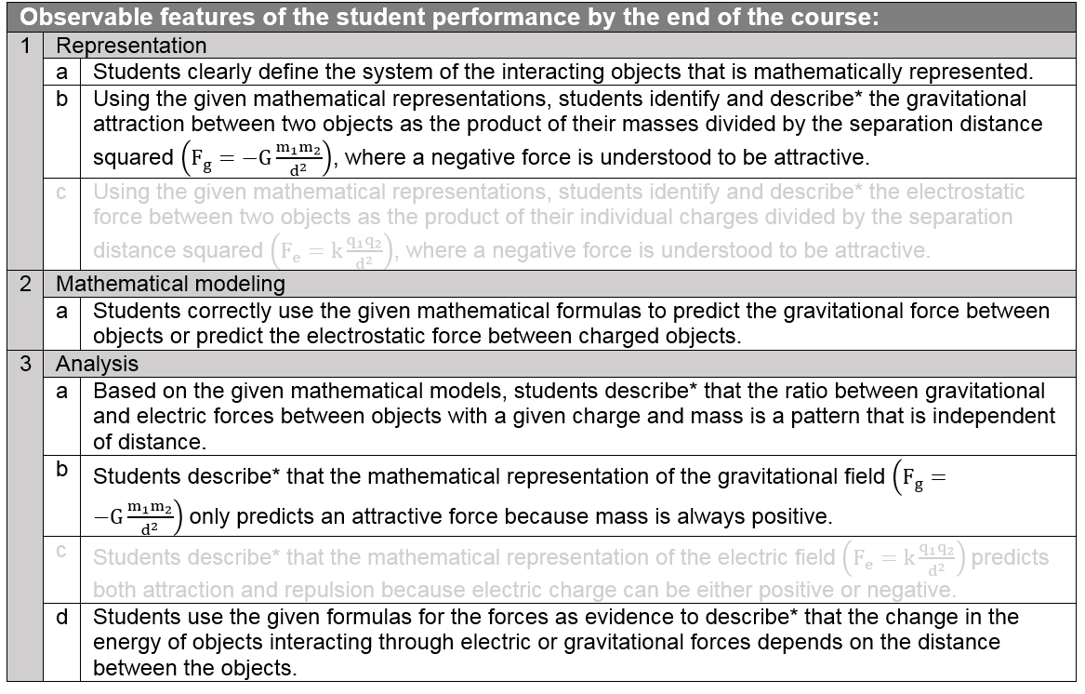
Evidence Statements
Notes:
Chris
Evidence Statements
Evidence statements shown in the bundles always describe summative assessment of a given PE or part of a PE. Because these are for summative purposes, some of the performance expectations will only be partially assessed in a bundle and some of the PEs evidence statements will be written in a light gray font to indicate that they are not assessed in this bundle.

Slide 26
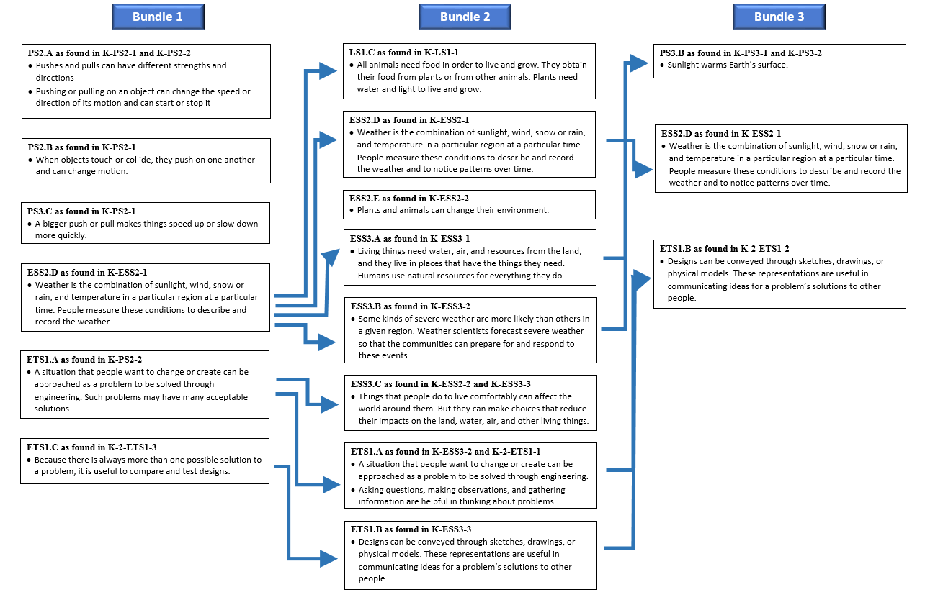
Course DCI Flowchart
Notes:
Chris
Example Bundle Course Flowchart
The Course Flow Chart shows the D C Is of the bundles in each course and indicates connections between each of the bundles. This provides a one-page overview of the progression of DCIs over the course of the school year and guides the classroom teacher as they intentionally emphasize the connections among and between concepts throughout the year. Building bridges between ideas will bring more meaning and endurance to student learning.

Slide 27
What Example Bundles are/are not?
What they are:
Illustrations of different ways to bundle
Representations of the best thinking of teams of educators
Guides for instructional unit design
What they are not:
Prescriptions about NGSS bundles
Perfect documents
Full curriculum documents
Notes:
Chris
What they are:
Illustrations of different ways to bundle
Representations of the best thinking of teams of educators
Guides for instructional unit design - The Example Bundles are not intended to be curricula or lesson plans, and they do not prescribe how educators should teach.
What they are not:
Prescriptions about NGSS bundles - The Example Bundles do not limit how many times a performance expectation can be included in a course or a grade range. Performance expectations can be partially taught over multiple units in a course, and they can also appear in multiple units within a course or across courses when appropriate for the context.
Perfect documents – these documents are examples
Full curriculum documents

Slide 28

Where Can I Find Them?
www.nextgenscience.org/bundling
Notes:
Chris
Where Can I Find Them?

Slide 29
Questions so far?
Notes:
Chris
There is no right way to bundle the Performance Expectations. There are literally thousands of ways to bundle the standards. You and/or your district will need to determine what will work best for your students.
(Chris transitions to Michael)

Slide 30
How could you use these?
Notes:
Michael

Slide 31
In the classroom we use Example Bundles as:
Starting points for planning…
Efficient way to conceptually align science content
Sense-making tools…
Digging into the standards instead of just reading them…helps teachers take ownership of the standards…
Tools that keep us from thinking of NGSS as checklist items…
Notes:
Michael

Slide 32
In the classroom we use Example Bundles as: (Continued)
Beginning organization of a Conceptual Flow…
Notes:
Michael

Slide 33
Correlations for Bundles used for Building Conceptual Flow
Big Unifying Concept
Bundle / Unit Concept
Bundle / Unit Concept
Bundle / Unit Concept
PE
PE
PE
PE
PE
PE.
PE
PE
PE
DCI
DCI
(Associated DCIs)
PE
DCI
DCI
DCI
(Associated DCIs)
DCI
DCI
DCI
(Associated DCIs)
Associated SEPs
For engaging in the content
Associated SEPs
For engaging in the content
Associated SEPs
For engaging in the content
Crosscutting Concepts
Notes:
Michael

Slide 34
Using Evidence Statements to Bundle

Slide 35
What are Evidence Statements?
Evidence statements provide detail on how students will use the
    - practices,
    - crosscutting concepts and
    - disciplinary core ideas
together to demonstrate proficiency on the PE’s.

Slide 36


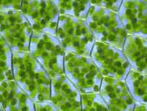
An Analogy
NGSS PE
Evidence Statements

Slide 37
Simple Bundle
MS-LS1-7. Develop a model to describe how food is rearranged through chemical reactions forming new molecules that support growth and/or release energy as this matter moves through an organism.
MS-PS1-5. Develop and use a model to describe how the total number of atoms does not change in a chemical reaction and thus mass is conserved.

Slide 38
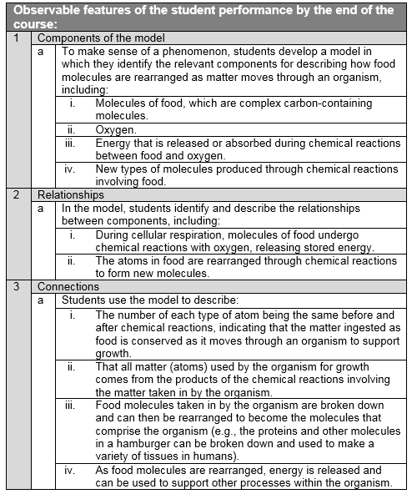
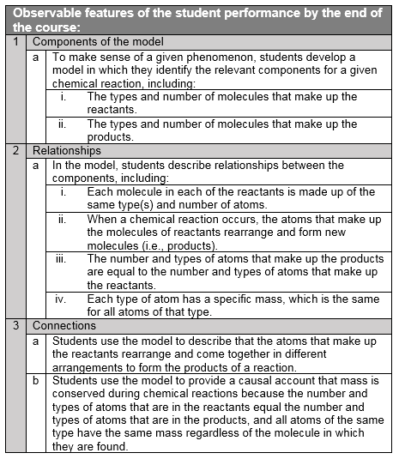
MS-LS1-7 and MS-PS1-5

Slide 39
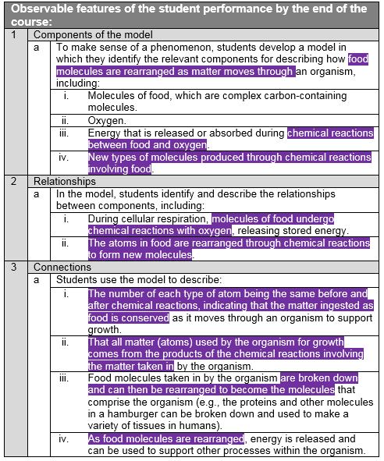
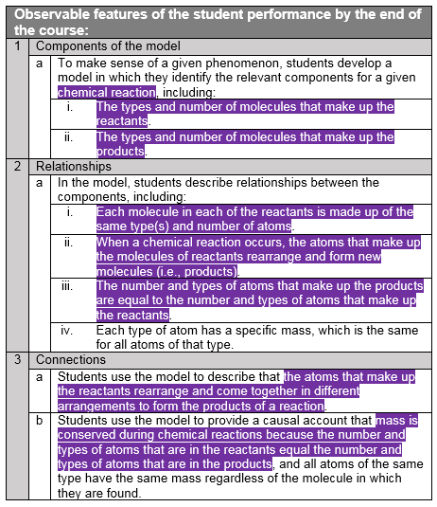
MS-LS1-7 and MS-PS1-5

Slide 40
Challenges
Classroom instruction and assessment should use many different, appropriate, combinations of
    - practices,
    - crosscutting concepts, and
    - disciplinary core ideas,
such that by the end of instruction students have had ample experience with all aspects of the three dimensions and how they work together to meet the goals set by the PE bundle.

Slide 41
Summary
Bundling can be a useful step in curriculum development
NGSS Example Bundles are a new resource to illustrate bundling
Users can and should create their own bundles

Slide 42
Which part of bundling or the Example Bundles would you most like to hear more about?
POLL QUESTION
Notes:
Jennifer
POLL #3: Which part of bundling or the Example Bundles would you most like to hear more about?
The rationale for bundling in this way
How I can use these bundles in planning instruction
How bundling is different for K-5 vs. 6-12 grade standards
Deeper explanations of the Example Bundle documents

Slide 43
Questions?
Notes:
Jennifer

Slide 44

Thank you for joining us!
www.nextgenscience.org
www.achieve.org
Notes:
Jennifer concludes the webinar

